Slide 1
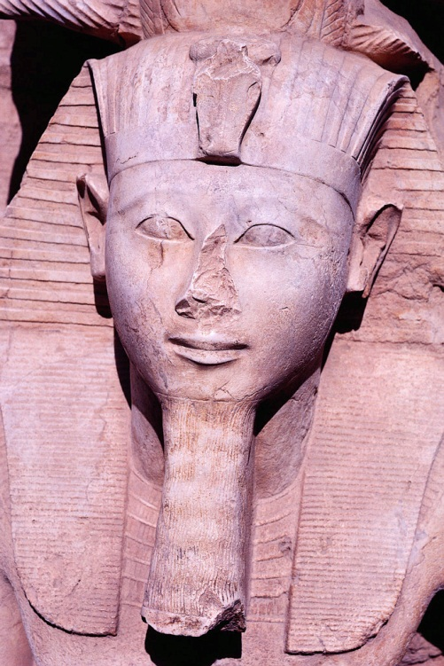
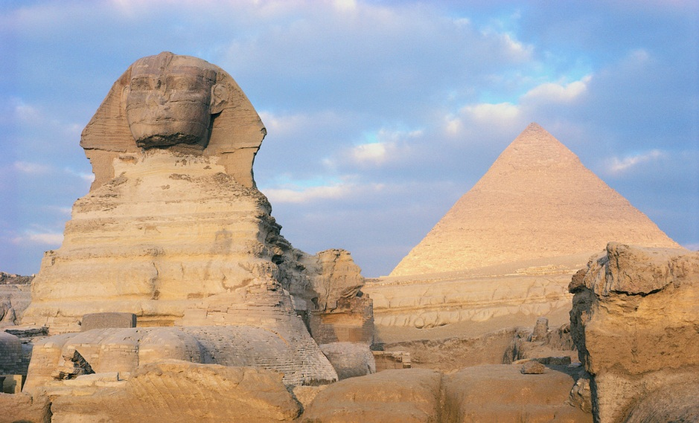
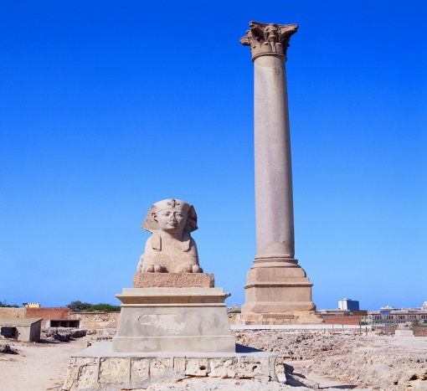
Ancient Civilization
By: Alexander Erwin

Slide 2
Timeline
Early Man
Mesopotamia
Egypt
India
China
Greece
Rome
Mayan Civilization
Medieval Europe
Exploration

Slide 3
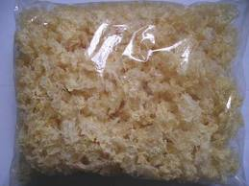
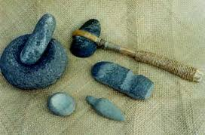
Early Man
The Early Man used stone tools. They also used fungus to cure wounds when traveling. The best preservation of an Early Man was Iceman. He was preserved in the Alps for 5,300 years.
Fungus
Stone Tools

Slide 4
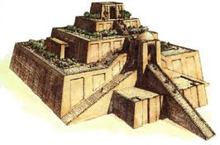
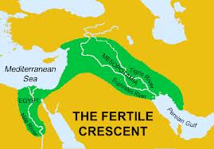
Mesopotamia
Mesopotamia means “Land between the rivers” and this region was known as the fertile crescent. The Sumerians were the first to claim this land. They developed a writing system known as cuneiform and they invented the wheel. They worshipped many gods in pyramid like temples known as a ziggurat.
Ziggurat
Fertile
Crescent

Slide 5
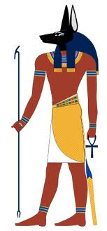
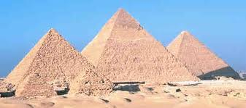
Egypt
The Egyptians have made many pyramids for tombs and have worshipped many gods, such as Anubis. The Egyptians also invented many items such as the wheel and papyrus. In the Egyptians time, iron was worth more than gold, due to the could only find iron in meteorites.
Anubis

Slide 6
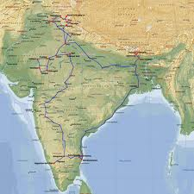
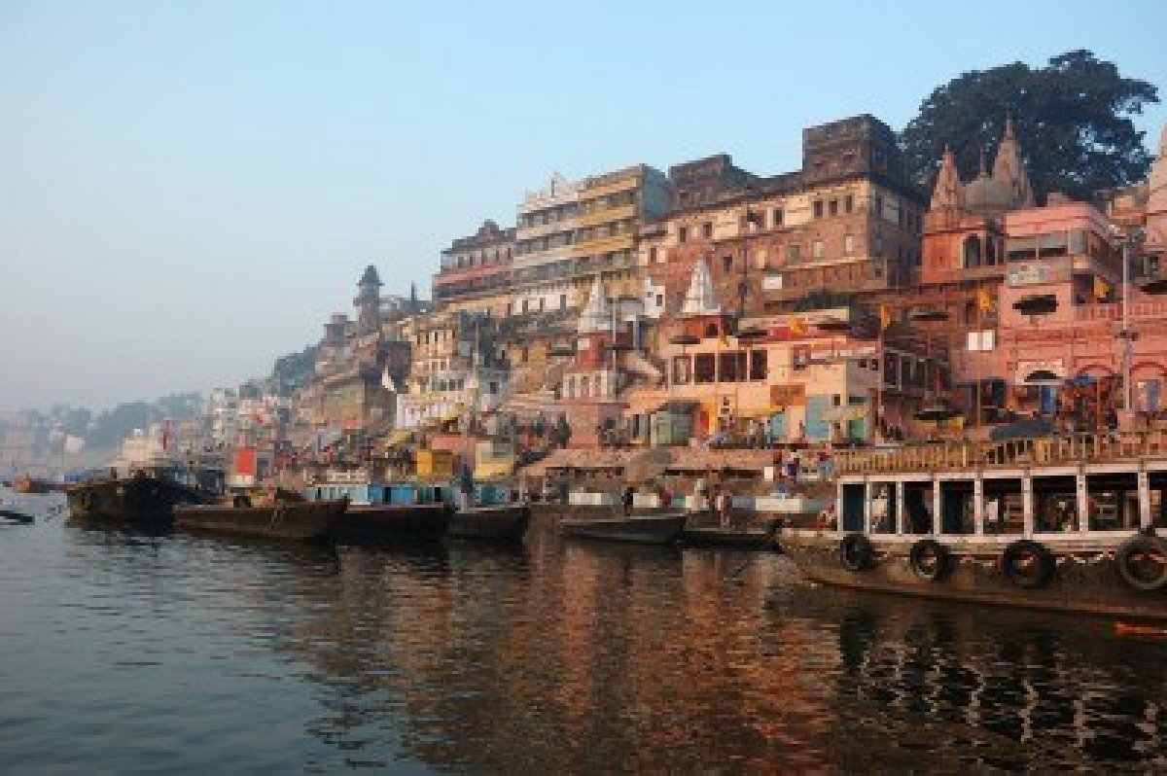
India
India is a sub-continent. It is cut off from the rest of the continent because of the Himalayas. Hinduism is in India. Their sacred writing is called “The Vedas”. The Ganges River is a sacred river. It is believed to wash away a person’s sins. Castes are shown with marks on the forehead. There are more than 3,000 castes in India.
The Ganges River

Slide 7
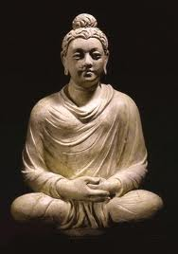
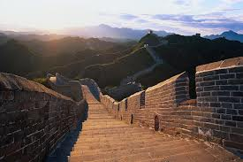
China
Ancient China made many of today’s inventions. This includes tea, gunpowder, and wheelbarrows. The Chinese also invented silk. To trade with the Europeans, they had to make something called the Silk Road. This enabled them to trade silk. To protect the country, they built the Great Wall Of China. This kept other tribes out. Buddhism was also popular in China. The Buddha said to live off of 4 rules and never be greedy.
The Buddha
The Great Wall Of China

Slide 8
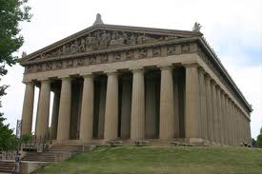
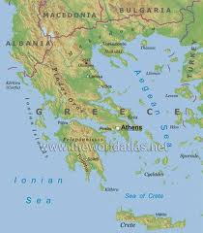
Greece
Greece’s 1st democracy and 1st city-state was Athens. Citizens voted on laws and took part in political debates. Sparta, Athens enemy, was an oligarchy, and was ruled by 2 kings. Sparta also had a powerful army. Greek believed in gods and honored them with myths, poems, and plays. The architecture by the Greek's was the world’s most impressive. Philosophers Socrates and Plato discussed ideas. These ideas were about politics, government, math, and astronomy.
Greek Architecture

Slide 9
Mesopotamia around 3000 BC
Mesopotamia means “Land between the rivers” and this region was known as the fertile crescent (see map above). The Sumerians were the first to claim this land. They developed a writing system known as cuneiform and they invented the wheel. They worshipped many gods in pyramid like temples known as a ziggurat ( see bottom left picture).

Slide 10
Mesopotamia around 3000 BC
Mesopotamia means “Land between the rivers” and this region was known as the fertile crescent (see map above). The Sumerians were the first to claim this land. They developed a writing system known as cuneiform and they invented the wheel. They worshipped many gods in pyramid like temples known as a ziggurat ( see bottom left picture).

Slide 11
Mesopotamia around 3000 BC
Mesopotamia means “Land between the rivers” and this region was known as the fertile crescent (see map above). The Sumerians were the first to claim this land. They developed a writing system known as cuneiform and they invented the wheel. They worshipped many gods in pyramid like temples known as a ziggurat ( see bottom left picture).

Slide 12
Mesopotamia around 3000 BC
Mesopotamia means “Land between the rivers” and this region was known as the fertile crescent (see map above). The Sumerians were the first to claim this land. They developed a writing system known as cuneiform and they invented the wheel. They worshipped many gods in pyramid like temples known as a ziggurat ( see bottom left picture).

